Slide 1
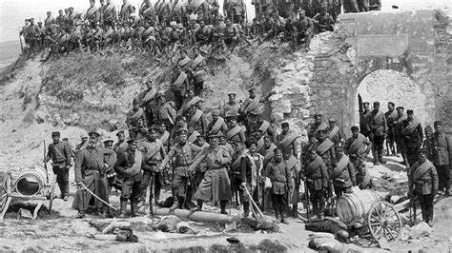


BA 3rd Year ( Annual) {DSC-1B: HIST (A)
307}
“CAUSES OF THE SECOND WORLD WAR”

Slide 2
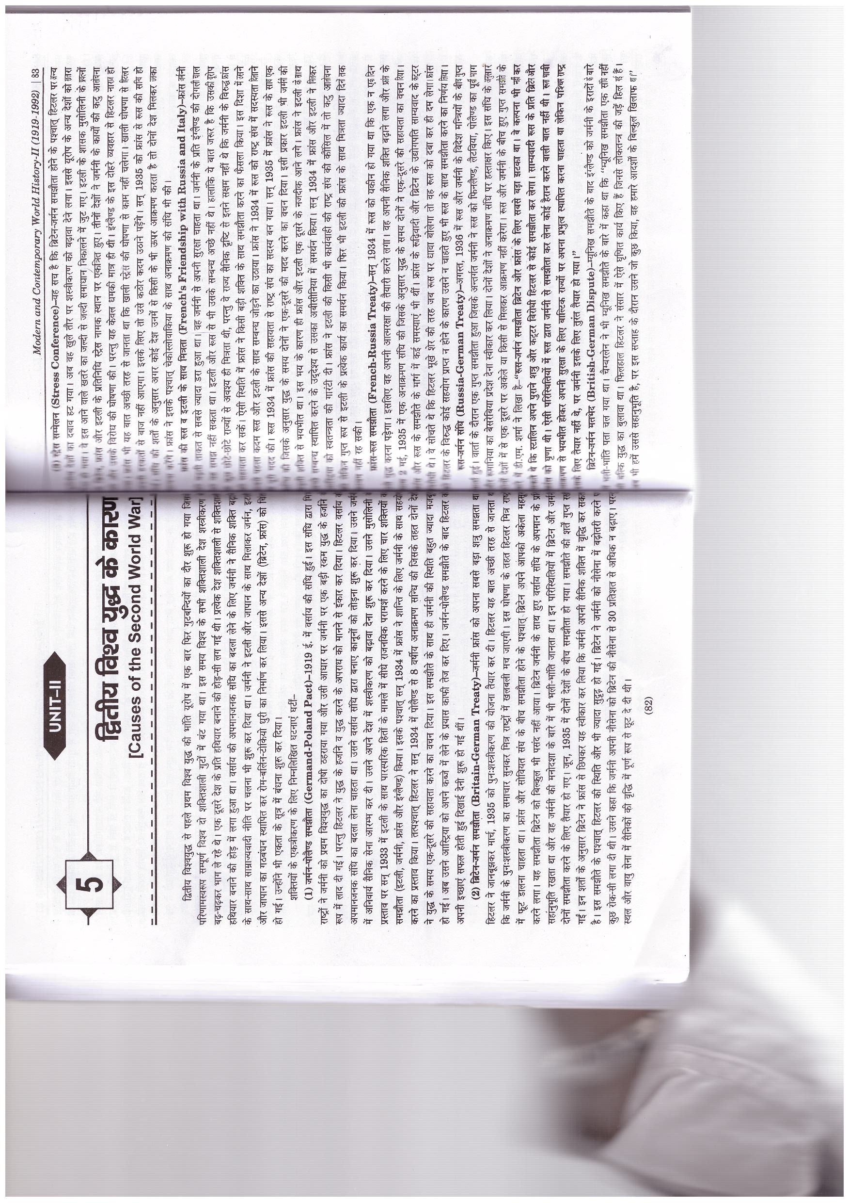
CAUSES OF THE WORLD WAR SECOND

Slide 4
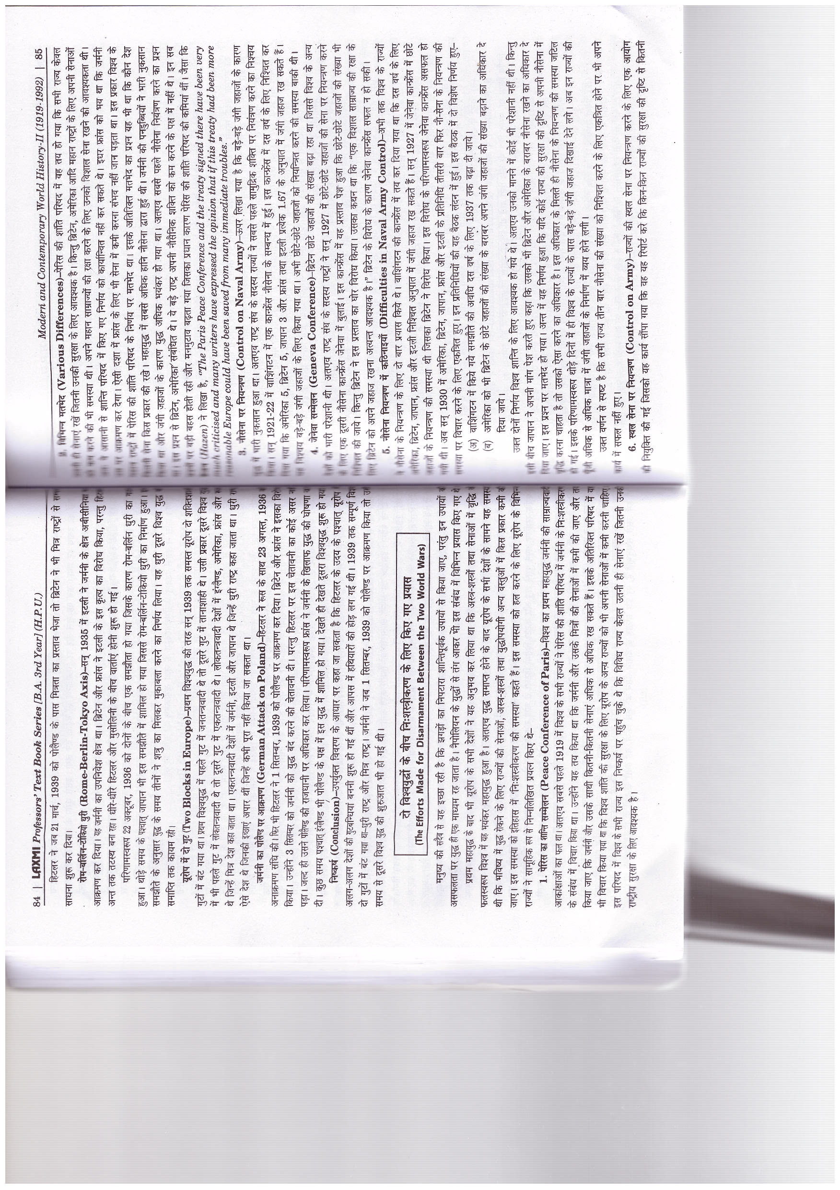

Slide 5
THE EFFORTS MADE FOR DISARMAMENT BETWEEN THE TWO WORLD WARS

Slide 7
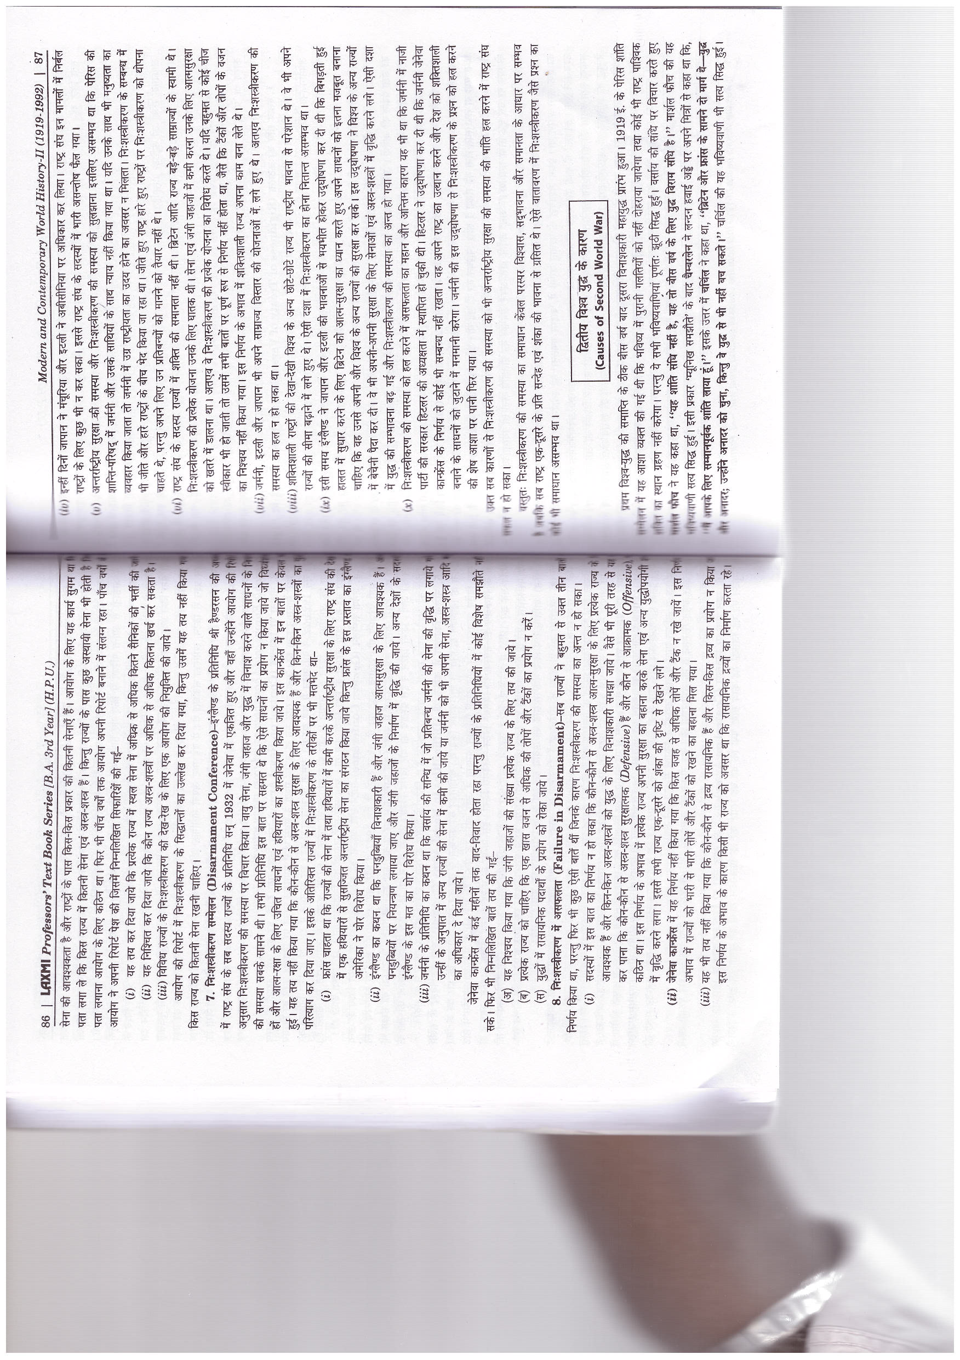

Slide 9
CAUSES OF SECOND WORLD WAR

Slide 10


Slide 12
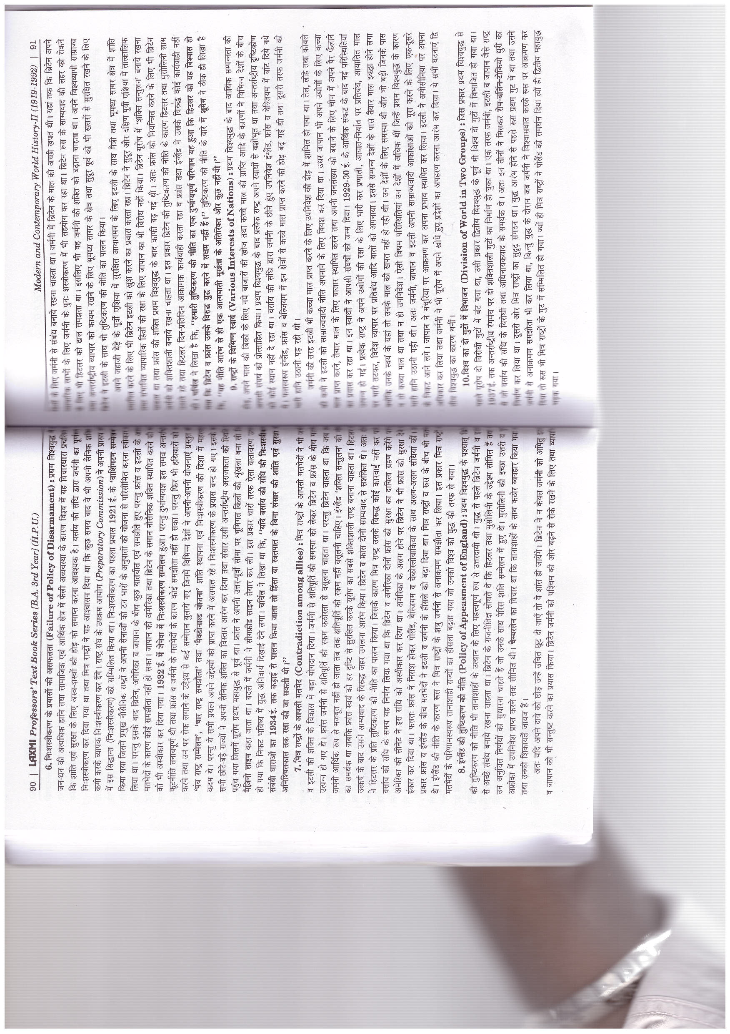

Slide 14
